Slide 1

Oxygen isotope fractionation in the CaCO3-DIC-H2O system Devriendt et al., 2017, GCA
Anne Fetrow | GEOL 5253 | in-class discussion and model exercise

Slide 2
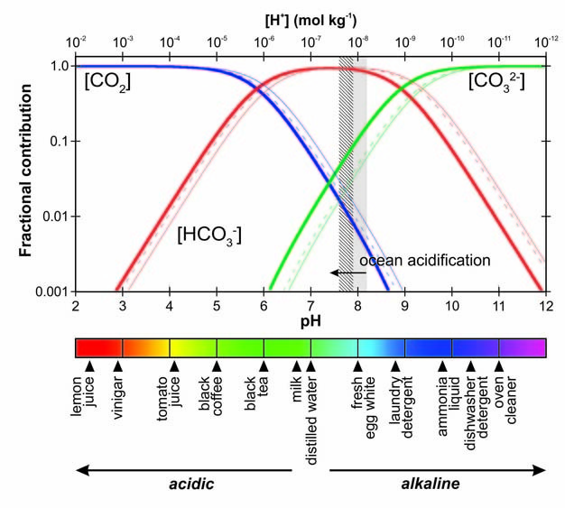
Carbonate Species
in Natural Waters
Carbonic Acid
Carbonate
CO₂ dissolves into water
Forms a cascade of weak acids
Concentration of species is dependent on pH of system
Bicarbonate
Barker and Ridgwell, 2012
Notes:
We are going to be focusing on the carbonate species in natural waters and tracking oxygen (could be doing carbon, but not right now)
This is showing a closed system example

Slide 3
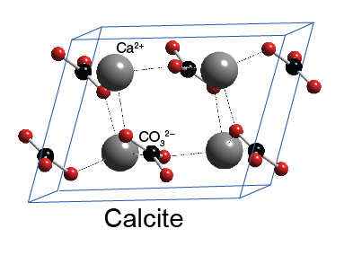

$$CO_{2 (g)}+H_{2}O_{(l)}⇌ H_{2}{CO}_{3 (aq)} K_{sp}={10}^{−1.5}$$
$$H_{2}{CO}_{3 (aq)}⇌{HCO}_{3 (aq)}^{−}+H_{(aq)}^{+}{ K}_{sp}={10}^{−6.3}$$
$${HCO}_{3 (aq)}^{−}⇌{CO}_{3 (aq)}^{2−}+H_{(aq)}^{+}{ K}_{sp}={10}^{−10.3}$$
$$DIC= ∑\left[H_{2}{CO}_{3 \left(aq\right)}\right]+\left[{HCO}_{3 (aq)}^{−}\right]+\left[{CO}_{3 (aq)}^{2−}\right]$$
$${CaCO}_{3 (s)}^{ }⇌ {Ca}_{(aq)}^{+}+{CO}_{3 (aq)}^{2−}{ K}_{sp}={10}^{−8.48}$$
Dissolved Inorganic Carbon
@ 25℃
calcite
Notes:
Cascade of speciation after CO2 gas dissolves into water
Sum of all of these species at any given time is DIC

Slide 4
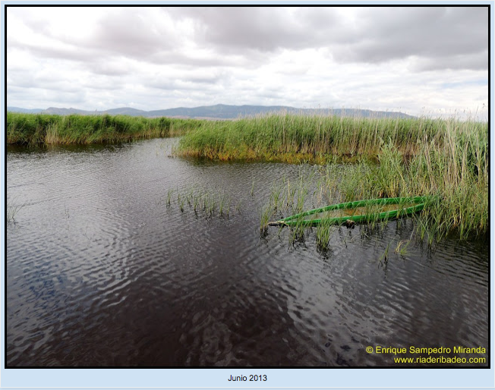
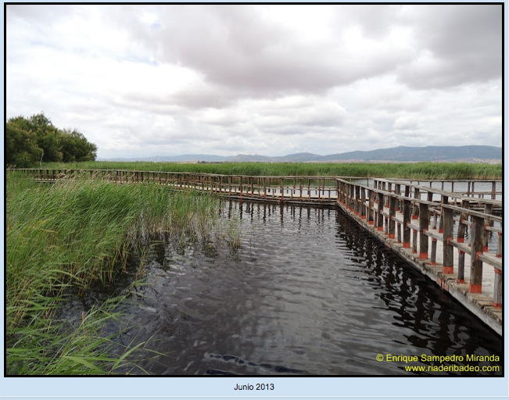
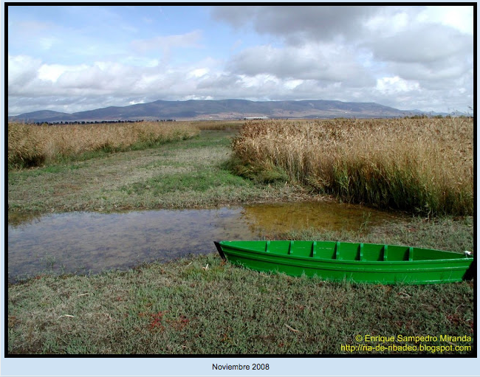
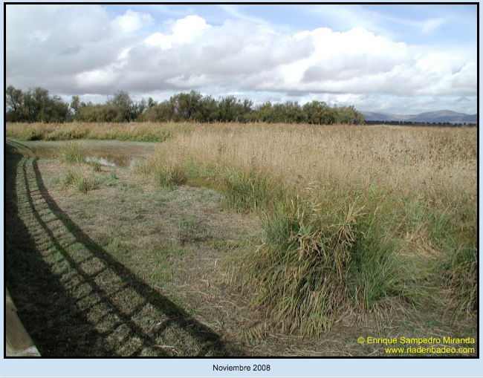
Personal research:
Understanding the timing and drivers of carbonate formation in palustrine environments
To create geochemical interpretive record to apply to ancient archives
Las Tablas de Daimiel NP, central Spain →
Notes:
I’m personally interested in better constraining oxygen isotope fractionation bc my research focuses on carbonate formation in shallow pond environments, such as the ones found in Las Tablas de Daimiel NP in Spain or in the Cretaceous formation I’m working on in Nevada.
These pictures show that throughout a single year, these environments can flood and then almost to completely dry down. We know that this environment is actively precipitating carbonate, so we are focused on constraining when during the year carbonate is forming. Bc this will have major implications for interpreting geochemical records from the past.

Slide 5
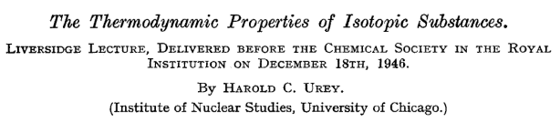
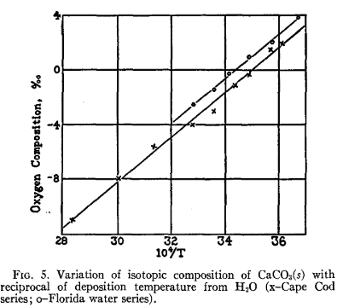
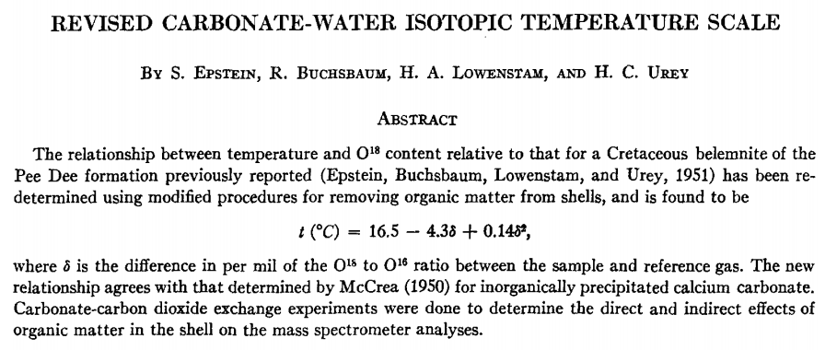
Temperature dependence of equilibrium fractionation of oxygen isotopes
Urey, 1947; McCrea, 1950;
Epstein et al., 1951, 1953;
Kim and O’Neil, 1997
McCrea, 1950
Notes:
The sensitivity of fractionation of d18O to temperature has been know for a long time and explored at great length.
Urey, published a key paper in 1947, exploring the thermodynamic properties of isotopic substances, explaining how and why isotopes are fractionated … making it possible to determine the temperatures at which geological formations were laid down.
Then McCrea came along and conducted experiments to test the theoretical calculation of oxygen fractionation between dissolved carbonate and water and between calcite and water
At the same time Epstein and others were also revising that temperature scale for naturally occurring samples --- Cretaceous Pee Dee Beleminite

Slide 6
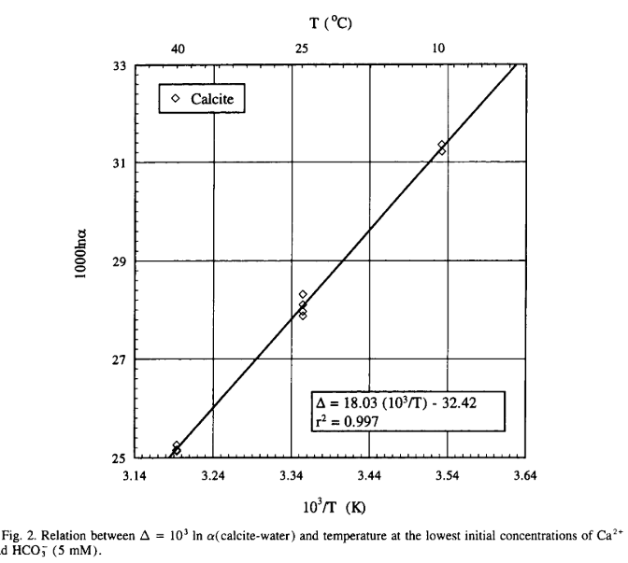

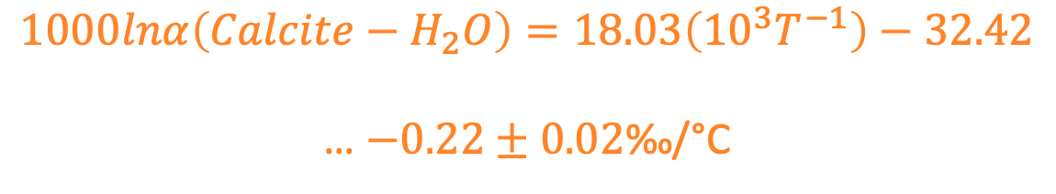
1997, GCA
$$1000lnα\left(Calcite−H_{2}O\right)=18.03\left({10}^{3}T^{−1}\right)−32.42$$
… $−0.22±0.02$﻿‰/°C
Synthesized Carbonates (Ca, Ca, Ba) across 10-40℃
Equilibrium dependent on ion concentrations
Commonly used for δ¹⁸O to temperature relationship
But temperature sensitivity of $α_{c/w}$ deviates
Disequilibrium!
Notes:
Kim and ONeil
But we know through various experiments and geologic observation that the fractionation factor does in fact vary from this proposed relationship, and the key explanation for that is disequilibrium. This has led to extensive and ongoing research trying to experimentally investigate and model disequilibria and kinetic isotope effects on carbonate precipitation

Slide 7
Watkins et al., 2014

Slide 8


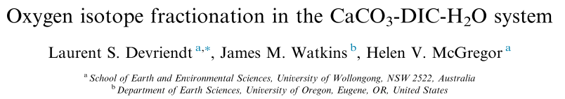
Often, isotopic exchange between chemical phases does not reach equilibrium
Probably in most natural systems?!
What can cause kinetic isotope effects (KIEs) in carbonates?
Precipitation rate of CaCO₃
Chemical speciation of DIC species
Solution pH
Notes:
Kinetic isotope effects within Carbonate precipitation

Slide 9

What do they present in this study?
model of oxygen isotope fractionation in the CaCO3-DIC-H2O system that incorporates
the new information on KIE between CaCO3 and DIC
model for kinetic and equilibrium oxygen isotope fractionation between calcite and water - $α_{c/w}$ - that accounts for fractionation between…
-- Calcite and carbonate ion pool - $α_{c/CO3}$
-- Carbonate ion and water - $α_{CO3/w}$
-- function of Temp, pH, salinity, saturation state (Ω),
residence time of DIC in solution, and activity of carbonic anhydrase
Notes:
model of oxygen isotope fractionation in the CaCO3-DIC-H2O system that incorporates
the new information on KIE between CaCO3 and DIC
model for kinetic and equilibrium oxygen isotope fractionation between calcite and water - $α_{c/w}$ - that accounts for fractionation between…
-- Calcite and carbonate ion pool - $α_{c/CO3}$
-- Carbonate ion and water - $α_{CO3/w}$
-- function of Temp, pH, salinity, saturation state (Ω),
residence time of DIC in solution, and activity of carbonic anhydrase

Slide 10
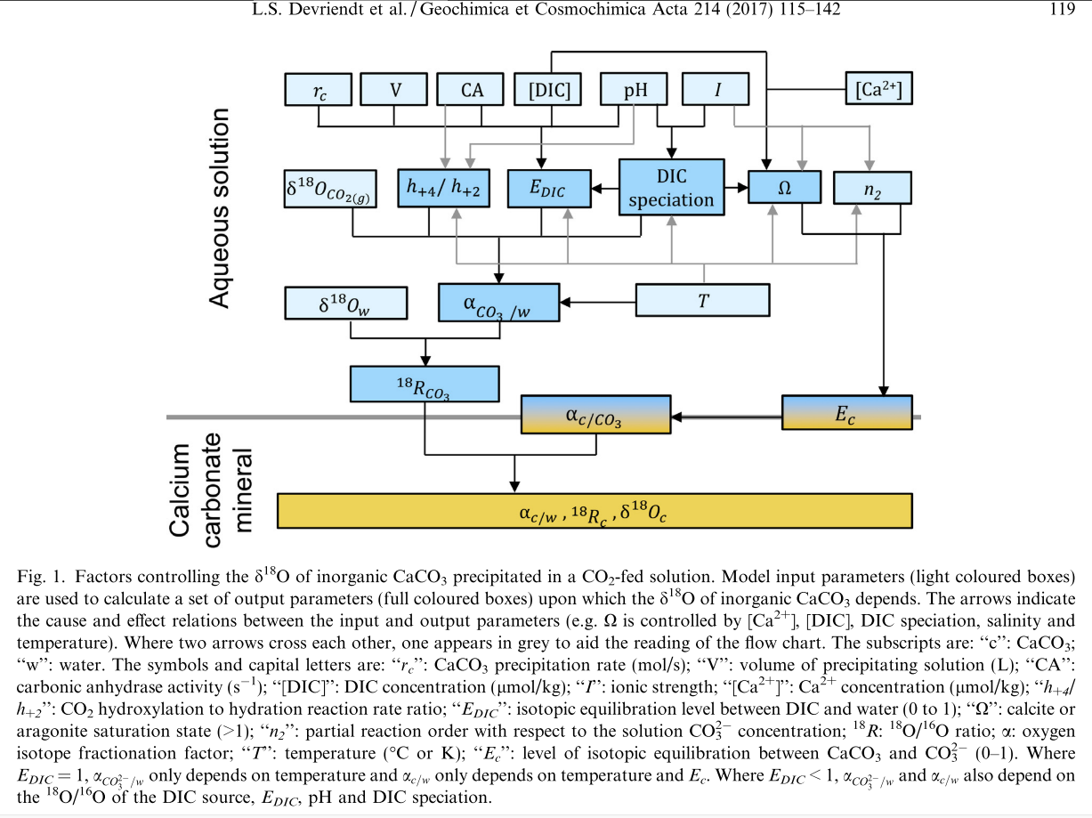
Model Overview: let’s define terms
Figure 1
Notes:
﻿‘‘rc’’: CaCO3 precipitation rate (mol/s);
‘‘V’’: volume of precipitating solution (L);
‘‘CA’’: carbonic anhydrase activity (s?1);
‘‘[DIC]’’: DIC concentration (lmol/kg);
‘‘I’’: ionic strength;
‘‘[Ca2+]’’: Ca2+ concentration (lmol/kg);
‘‘h+4/ h+2’’: CO2 hydroxylation to hydration reaction rate ratio;
‘‘EDIC’’: isotopic equilibration level between DIC and water (0 to 1);
‘‘X’’: calcite or aragonite saturation state (>1);
‘‘n2’’: partial reaction order with respect to the solution CO3 concentration;
18R: 18O/16O ratio;
alpha: oxygen isotope fractionation factor;
‘‘T’’: temperature (°C or K);
‘‘Ec’’: level of isotopic equilibration between CaCO3 and CO3 2? (0–1).

Slide 12


$α_{c/w}= \frac{\frac{ ^{18}R_{c}}{ ^{18}R_{CO3}}}{\frac{ ^{18}R_{w}}{ ^{18}R_{CO3}}}=α_{c/CO3}$* $α_{cO3/w}$
At equilibrium, varies only with Temperature
…. Kim and O’Neil, 1997 and Beck et al., 2005
At disequilibrium, varies with Ro of DIC source, DIC-H2O exchange, degree of isotopic equilibrium between DIC and water (E_{DIC})
E_{DIC} varies (0-1) b/c of DIC residence time in solution and rate of O exchange between DIC-water
$$E_{c}=1 …equilibrium is reached$$
$$E_{c}=0 …disequilibrium limit$$
Dependent on dissolution reaction rate,
Inferred by saturation state (Ω) and
Solution ionic strength (partial reaction order for carb ions… n_{2_})
Equilibrium between Calcite-DIC-H2O at same time is very unlikely ☹

Slide 13
To improve interpretations of d18O data from modern and fossil carbonates, there is a need to better understand:
Which DIC species contribute to CaCO₃ growth?
Why do should we care?
Strongly pH dependent
Fractionation between each DIC species, so impacts the isotopic pool from which CaCO3 precipitates
Barker and Ridgwell, 2012
Notes:
The authors lay our 3 key Questions that we need to answer if we want to improve how we interpret and model d18O data. Let’s walk through those and they they are important and then talk about the model a little bit
Why do we need to care ? the proportion of the three DIC species contribution to calcite nucleation will determined from what ‘isotopic reservoir’ the calcite is pulling from. Bc each step in the deprotonation reactions will have a different isotopic fractionation

Slide 14

Contribution of DIC species to CaCO₃ growth
$$DIC= ∑\left[H_{2}{CO}_{3 \left(aq\right)}\right]+\left[{HCO}_{3 (aq)}^{−}\right]+\left[{CO}_{3 (aq)}^{2−}\right]$$
$$CO_{2 (g)}+H_{2}O_{(l)}⇌ H_{2}{CO}_{3 (aq)} K_{sp}={10}^{−1.5}$$
$$H_{2}{CO}_{3 (aq)}⇌H_{(aq)}^{+}+{HCO}_{3 (aq)}^{−}{ K}_{sp}={10}^{−6.3}$$
$${HCO}_{3 (aq)}^{−}⇌H_{(aq)}^{+}+{CO}_{3 (aq)}^{2−}{ K}_{sp}={10}^{−10.3}$$
$${CaCO}_{3 (s)}^{ }+H_{2}{CO}_{3 (aq)}⇌ {Ca}_{(aq)}^{+}+{2HCO}_{3 (aq)}^{−}$$
$${CaCO}_{3 (s)}^{ }⇌ {Ca}_{(aq)}^{+}+{CO}_{3 (aq)}^{2−}$$
What assumption is made about the contributing DIC species for this model?
${CO}_{3 (aq)}^{2−}$is the only DIC species contributing to carbonate mineral formation
Notes:
Several recent studies suggest that ${CO}_{3 (aq)}^{2−}$ is the dominant contributor to carbonate nucleation.
Both other recent models demand participation by ${HCO}_{3 (aq)}^{−}$ to explain observed mineral growth rates in low pH soln’s
- Why at low pH studies? Bc bicarbonate is dominant species between pH 6.3 and 10.3

Slide 15
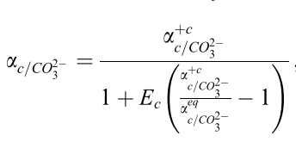
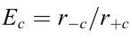

To improve interpretations of d18O data from modern and fossil carbonates, there is a need to better understand:
(2) What controls the isotopic fractionations between the precipitating DIC species and CaCO₃?
This model relies on principle that oxygen isotope fractionation during mineral growth is governed by calcite dissolution/precipitation ratio
-- Following work by DePaulo (2011) and Watkins et al., (2014)
$r_{−c}$is the backward rate (dissolution)
$r_{+c}$ is the forward rate (precipitation)

Slide 16
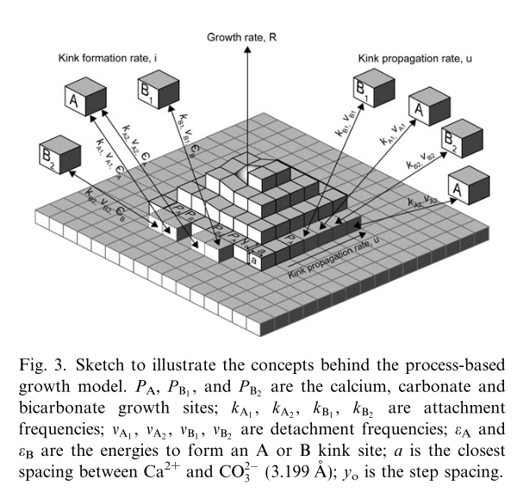
Wolthers et al., 2012

Slide 17
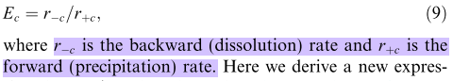
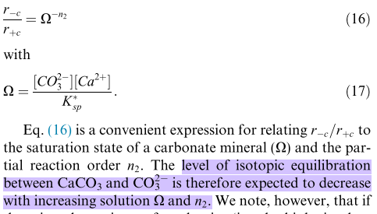
Result 1: Equilibrium α_{c/w} only approached at low omega and low ionic strength
4.2.1 Kinetic vs equilibrium isotope fractionation -- p.119
Notes:
If saturation state increases, isotopic equilibrium between calcite and carbonate ion will decrease!
So for super saturated solutions (like ponds?), equilibrium will be very unlikely to occur

Slide 18
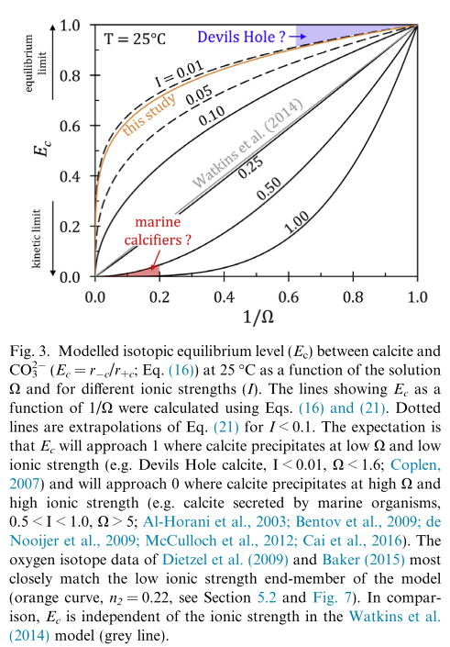

Result 1: Equilibrium α_{c/w} only approached at low omega and low ionic strength
What implications does this result have on the assumption of equilibrium within δ¹⁸O systems?
High omega or ionic strength systems…. Not in equilibrium
Ex: Oceans, lakes, super-saturation due to dry-downs (wetlands or soils)
$α_{c/w}$ = 1.00542 at 33.7C
Figure 3
Notes:
If saturation state increases, isotopic equilibrium between calcite and carbonate ion will decrease!
So for super saturated solutions (like ponds?), equilibrium will be very unlikely to occur

Slide 19
Notes:
So where should we be looking for naturally occurring systems that are at near equilibrium?

Slide 20
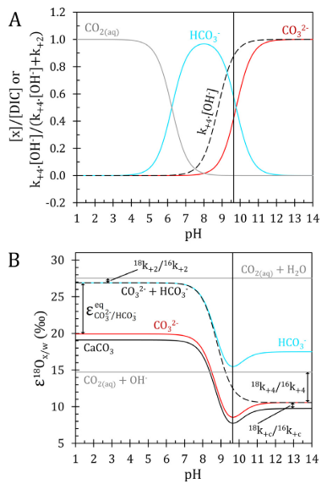
Result 2: Sensitivity of α_{c/w} to pH and mineral growth rate depends on level of isotopic equilibrium between carbonate ion and water
﻿When the precipitating CO₃²⁻ pool approaches isotopic equilibrium with water…
small negative pH and/or growth effects on α_{c/w} occur because these parameters are positively correlated with saturation state (Ω)
Disequilib effects between carbonate ion and water can lead to strong pH effects on α_{c/w} depending on the chemical pathways along the way to generating carbonate ions
(de)hydration and (de)hydroxylation
Figure 5

Slide 21
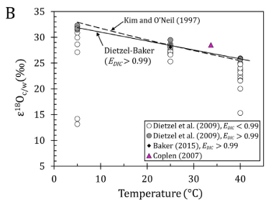
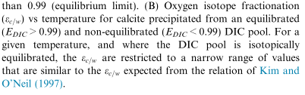
(Q3) How does the isotopic composition of DIC species vary prior to and during CaCO₃ precipitation?
Result 3: ﻿Temperature dependence of α_{c/w} originates from the effect of temperature on the ¹⁸O/¹⁶O of CO₃²⁻ in solution.
What happens when the CO₃²⁻ pool does not reach isotopic equilibrium with the water pool prior to CaCO₃ precipitation?
Temp sensitivity of α_{c/w} will deviate from Kim and O’Neil 1997 value
Implies that disequilibrium between with calcite and carbonate ion had little effect on α_{c/w}
Figure 6

Slide 22
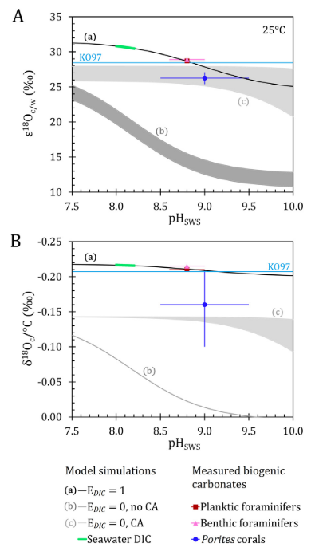
Result 4: δ¹⁸O-temperature relationship for forams vs corals?
Relatively constant foram calcite δ¹⁸O-temperature relationship but a more variable coral aragonite δ¹⁸O-temp relationship
Implications for us?
Good news for foram paleothermometry!
Notes:
Forams: model suggests that the IDC of calcifying fluid is at iso equilib at pH ~ 8.8 prior to calcite precip
Corals: precip of internal DIC derived from hydrated CO2 and minimal subsequent DIC-H2O iso equilibrium…
What do the authors say about the foram d18O thermometer?
﻿- d18O-thermometer should work well with foraminiferal cal-cite as long as the carbonate chemistry of the CF remained
similar between specimens from the same species.
Overall: ﻿
model results suggest that inorganic processes are sufficient to explain oxygen isotope ‘‘vital effects’’
in foraminifers while the catalytic effect of carbonic anhydrase on CO2 hydration is a likely explanation for vital
effects in coral d18O.

Slide 23
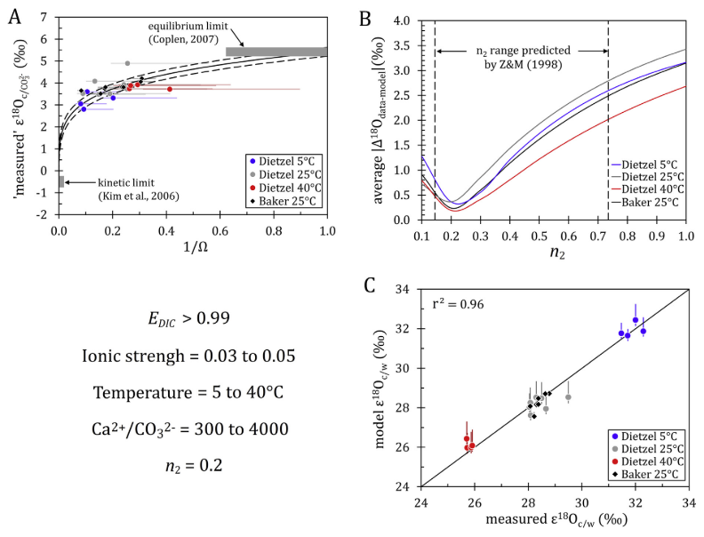
Notes:
Measured alpha (c=w) where calcite precipitated from an isotopically equilibrated pool show temperature-independent variations of more than 1.0‰

Slide 24
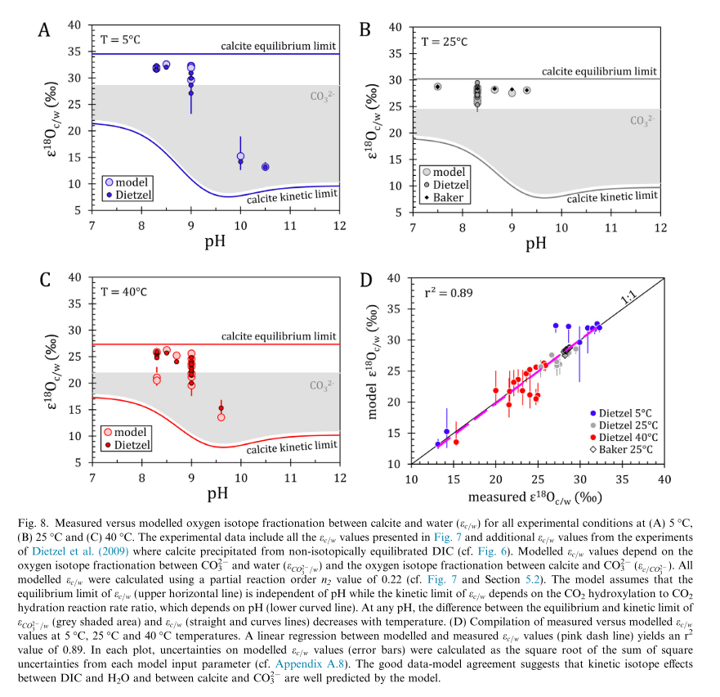

Slide 25
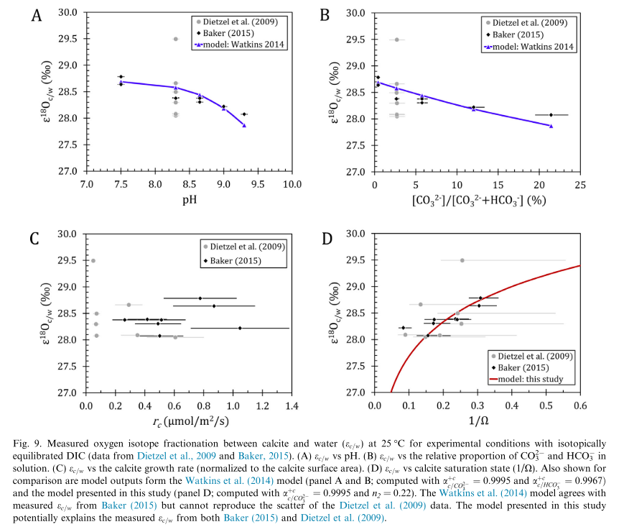

Slide 26
Motivation for exploring this system
Interested in tracking oxygen (also carbon) through speciation and precipitation of carbonate minerals in terrestrial aqueous systems
Specifically… palustrine environment
Las Tablas de Daimiel
What environmental factors influence the timing and extent of precipitation of carbonates in palustrine settings?

Slide 27
Model Objectives: Open, steady state model for δ¹⁸O within carbonate equilibria system.
Fix pH
At steady state, what is the effect the concentration of CO2 in the atmosphere?
Geologic example of super high pCO2 – Cretaceous Thermal Optimum
2) How does the temperature of the system impact the isotopic composition of the system, particularly the precipitating calcite?
Going from ‘spring temps’ (20 C) to ‘late summer’ (35 C)
Fractionation factors, but also equilibrium will happen faster?, but also CO2 will outgas from the water?
3) Make not steady state? – carb precipitation rate is higher than ability for CO2 to diffuse into water
Example: temperature of system increased or concentrations of [Ca²⁺] or [CO₃²⁻] calcite became super saturated
(dry down)
Assumptions
- Carbonate species of interest is CO₃²⁻ and is the only species that participates in precipitation of calcite

Slide 28
Exploring an open, steady state system for carbonate equilibria
[CO₂] essentially infinite because the aqueous environment is constantly exchanging with the atmosphere
CaCO₃ - Calcite
Notes:
System of interest: following oxygen isotopes within aqueous speciation in open, steady state system. System is at steady state bc calcite mineral precipitation is falling out of solution also.

Slide 29
open, steady state system for carbonate equilibria
$$CO_{2 (g)}+H_{2}O_{(l)}⇌ H_{2}{CO}_{3 (aq)}⇌{HCO}_{3 (aq)}^{−}+H_{(aq)}^{+}⇌{CO}_{3 (aq)}^{2−}+H_{(aq)}^{+}{⇌CaCO}_{3 (s)}^{ }$$
CaCO₃ - Calcite

Slide 30
open, steady state system for carbonate equilibria
Atmosphere
(A)
Carbonic
Acid (CA)
Bicarbonate
(Bi)
Carbonate
(carb)
Calcite
(min)
$$CO_{2 (g)}+H_{2}O_{(l)}⇌ H_{2}{CO}_{3 (aq)}⇌{HCO}_{3 (aq)}^{−}+H_{(aq)}^{+}⇌{CO}_{3 (aq)}^{2−}+H_{(aq)}^{+}{⇌CaCO}_{3 (s)}^{ }$$
CaCO₃ - Calcite

Slide 31
Inputs – External Node
Aqueous Environment – Internal Nodes
Outputs – External Node
Atmosphere
(A)
Carbonic
Acid (CA)
Bicarbonate
(Bi)
Carbonate
(carb)
Calcite
(min)
$$CO_{2 (g)}+H_{2}O_{(l)}⇌ H_{2}{CO}_{3 (aq)}⇌{HCO}_{3 (aq)}^{−}+H_{(aq)}^{+}⇌{CO}_{3 (aq)}^{2−}+H_{(aq)}^{+}{⇌CaCO}_{3 (s)}^{ }$$
CaCO₃ - Calcite

Slide 32
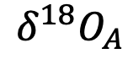
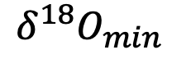
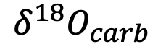
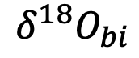
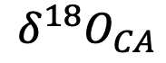
Inputs – External Node
Aqueous Environment – Internal Nodes
Outputs – External Node
Atmosphere
(A)
Carbonic
Acid (CA)
Bicarbonate
(Bi)
Carbonate
(carb)
Calcite
(min)
$$CO_{2 (g)}+H_{2}O_{(l)}⇌ H_{2}{CO}_{3 (aq)}⇌{HCO}_{3 (aq)}^{−}+H_{(aq)}^{+}⇌{CO}_{3 (aq)}^{2−}+H_{(aq)}^{+}{⇌CaCO}_{3 (s)}^{ }$$
$$δ^{18}O_{A}$$
$$δ^{18}O_{CA}$$
$$δ^{18}O_{bi}$$
$$δ^{18}O_{carb}$$
$$δ^{18}O_{min}$$
CaCO₃ - Calcite

Slide 33
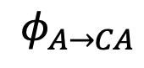
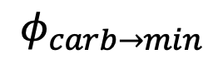
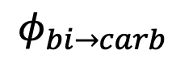
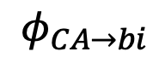
Inputs – External Node
Aqueous Environment – Internal Nodes
Outputs – External Node
Atmosphere
(A)
Carbonic
Acid (CA)
Bicarbonate
(Bi)
Carbonate
(carb)
Calcite
(min)
$$CO_{2 (g)}+H_{2}O_{(l)}⇌ H_{2}{CO}_{3 (aq)}⇌{HCO}_{3 (aq)}^{−}+H_{(aq)}^{+}⇌{CO}_{3 (aq)}^{2−}+H_{(aq)}^{+}{⇌CaCO}_{3 (s)}^{ }$$
$$δ^{18}O_{A}$$
$$δ^{18}O_{CA}$$
$$δ^{18}O_{bi}$$
$$δ^{18}O_{carb}$$
$$δ^{18}O_{min}$$
$$φ_{A→CA}$$
$$φ_{CA→bi}$$
$$φ_{bi→carb}$$
$$φ_{carb→min}$$
CaCO₃

Slide 34
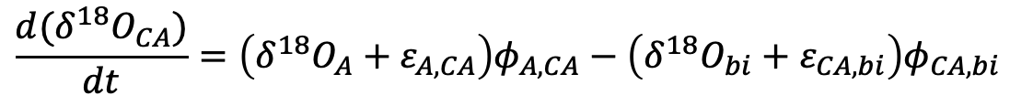
Inputs – External Node
Aqueous Environment – Internal Nodes
Outputs – External Node
Atmosphere
(A)
Carbonic
Acid (CA)
Bicarbonate
(bi)
Carbonate
(carb)
Calcite
(min)
$$CO_{2 (g)}+H_{2}O_{(l)}⇌ H_{2}{CO}_{3 (aq)}⇌{HCO}_{3 (aq)}^{−}+H_{(aq)}^{+}⇌{CO}_{3 (aq)}^{2−}+H_{(aq)}^{+}{⇌CaCO}_{3 (s)}^{ }$$
$$δ^{18}O_{A}$$
$$δ^{18}O_{CA}$$
$$δ^{18}O_{bi}$$
$$δ^{18}O_{carb}$$
$$δ^{18}O_{min}$$
$$φ_{A→CA}$$
$$φ_{CA→bi}$$
$$φ_{bi→carb}$$
$$φ_{carb→min}$$
$$\frac{d(δ^{18}O_{carb})}{dt}=\left(δ^{18}O_{bi}+ε_{bi,carb}\right)φ_{bi,carb}−\left(δ^{18}O_{min}+ε_{carb, min}\right)φ_{carb,min}$$
$$\frac{d(δ^{18}O_{bi})}{dt}=\left(δ^{18}O_{CA}+ε_{CA,bi}\right)φ_{CA,bi}−\left(δ^{18}O_{carb}+ε_{bi,carb}\right)φ_{bi,carb}$$
$$\frac{d(δ^{18}O_{CA})}{dt}=\left(δ^{18}O_{A}+ε_{A,CA}\right)φ_{A,CA}−\left(δ^{18}O_{bi}+ε_{CA,bi}\right)φ_{CA,bi}$$

Slide 35
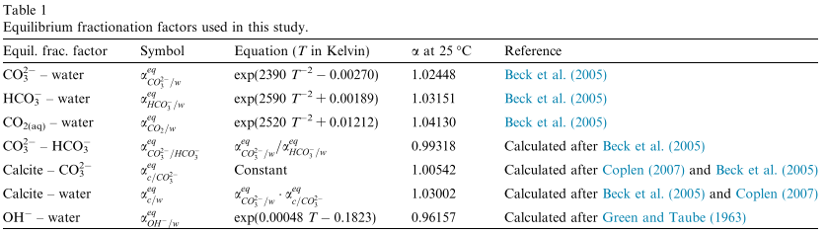

Slide 36
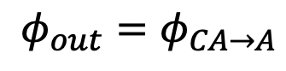
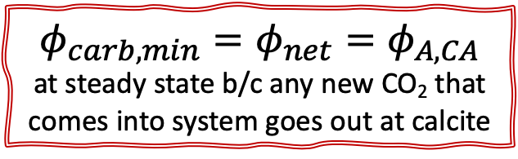
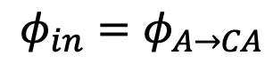
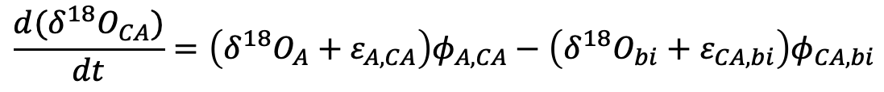
Inputs – External Node
Aqueous Environment – Internal Nodes
Outputs – External Node
Atmosphere
(A)
Carbonic
Acid (CA)
Bicarbonate
(bi)
Carbonate
(carb)
Calcite
(min)
$$CO_{2 (g)}+H_{2}O_{(l)}⇌ H_{2}{CO}_{3 (aq)}⇌{HCO}_{3 (aq)}^{−}+H_{(aq)}^{+}⇌{CO}_{3 (aq)}^{2−}+H_{(aq)}^{+}{⇌CaCO}_{3 (s)}^{ }$$
$$δ^{18}O_{A}$$
$$δ^{18}O_{CA}$$
$$δ^{18}O_{bi}$$
$$δ^{18}O_{carb}$$
$$δ^{18}O_{min}$$
$$φ_{in}=φ_{A→CA}$$
$$φ_{CA→bi}$$
$$φ_{bi→carb}$$
$$φ_{carb→min}$$
$$φ_{out}=φ_{CA→A}$$
$$\frac{d(δ^{18}O_{carb})}{dt}=\left(δ^{18}O_{bi}+ε_{bi,carb}\right)φ_{bi,carb}−\left(δ^{18}O_{min}+ε_{carb, min}\right)φ_{carb,min}$$
$$\frac{d(δ^{18}O_{bi})}{dt}=\left(δ^{18}O_{CA}+ε_{CA,bi}\right)φ_{CA,bi}−\left(δ^{18}O_{carb}+ε_{bi,carb}\right)φ_{bi,carb}$$
$$φ_{carb,min}=φ_{net}=φ_{A,CA}$$
at steady state b/c any new CO₂ that comes into system goes out at calcite
$$\frac{d(δ^{18}O_{CA})}{dt}=\left(δ^{18}O_{A}+ε_{A,CA}\right)φ_{A,CA}−\left(δ^{18}O_{bi}+ε_{CA,bi}\right)φ_{CA,bi}$$

Slide 37
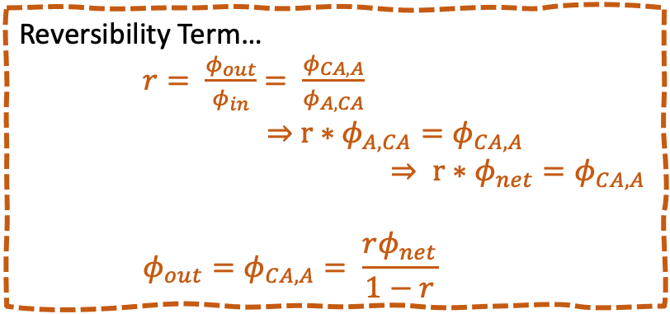

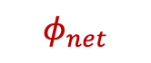
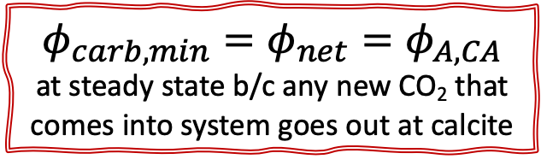
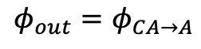
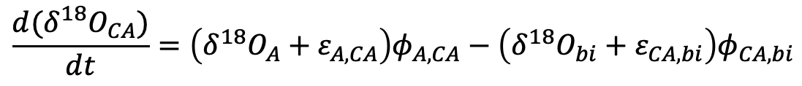
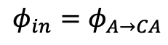
$$\frac{d(δ^{18}O_{carb})}{dt}=\left(δ^{18}O_{bi}+ε_{bi,carb}\right)φ_{bi,carb}−\left(δ^{18}O_{min}+ε_{carb, min}\right)φ_{carb,min}$$
$$φ_{out}=φ_{CA→A}$$
$$φ_{net}$$
$$φ_{in}=φ_{A→CA}$$
$$\frac{d(δ^{18}O_{bi})}{dt}=\left(δ^{18}O_{CA}+ε_{CA,bi}\right)φ_{CA,bi}−\left(δ^{18}O_{carb}+ε_{bi,carb}\right)φ_{bi,carb}$$
$$φ_{carb,min}=φ_{net}=φ_{A,CA}$$
at steady state b/c any new CO₂ that comes into system goes out at calcite
$$\frac{d(δ^{18}O_{CA})}{dt}=\left(δ^{18}O_{A}+ε_{A,CA}\right)φ_{A,CA}−\left(δ^{18}O_{bi}+ε_{CA,bi}\right)φ_{CA,bi}$$
$$φ_{net}$$
Reversibility Term…
$r= \frac{φ_{out}}{φ_{in}}$ $= \frac{φ_{CA,A}}{φ_{A,CA}}$
$⇒$ $r∗φ_{A,CA}=φ_{CA,A}$
$⇒ r∗φ_{net}=φ_{CA,A}$
$${φ_{out}=φ}_{CA,A}= \frac{rφ_{net}}{1−r}$$
…once I do this right, I can continue to substitute terms and simplify the equations to get to one, simple(ish) model equation

Slide 38
Model Equation…

Slide 39
Parameters…

Slide 40
$$CO_{2 (g)}+H_{2}O_{(l)}⇌ H_{2}{CO}_{3 (aq)} K_{sp}={10}^{−1.5}$$
$$H_{2}{CO}_{3 (aq)}⇌{HCO}_{3 (aq)}^{−}+H_{(aq)}^{+}{ K}_{sp}={10}^{−6.3}$$
$${HCO}_{3 (aq)}^{−}⇌{CO}_{3 (aq)}^{2−}+H_{(aq)}^{+}{ K}_{sp}={10}^{−10.3}$$
$$DIC= ∑\left[H_{2}{CO}_{3 \left(aq\right)}\right]+\left[{HCO}_{3 (aq)}^{−}\right]+\left[{CO}_{3 (aq)}^{2−}\right]$$
$${CaCO}_{3 (s)}^{ }⇌ {Ca}_{(aq)}^{+}+{CO}_{3 (aq)}^{2−}{ K}_{sp}={10}^{−8.48}$$
Dissolved Inorganic Carbon
@ 25℃
calcite

Slide 41
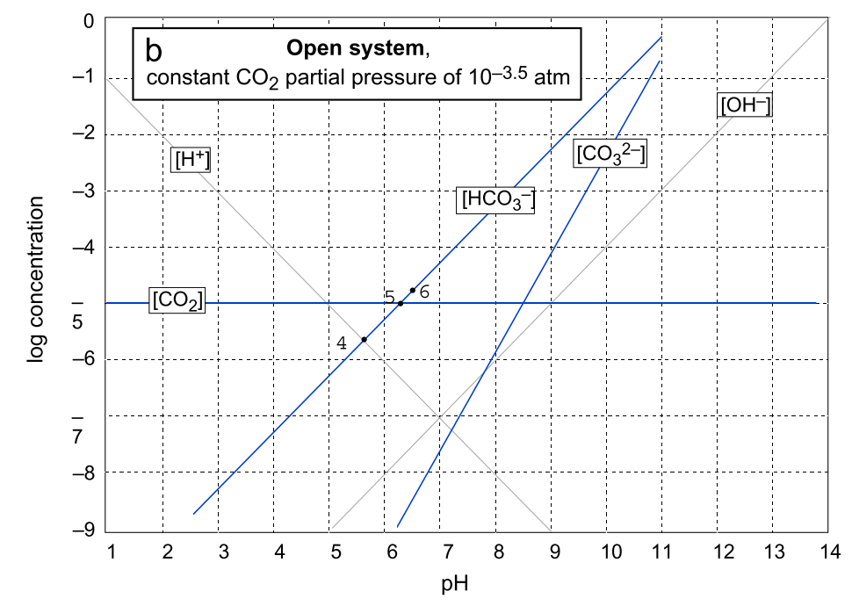
Notes:
The diagram in this slide is a plot of log concentration vs. pH for an open CO₂-H₂O system with p_{CO2} = 10^{-3.5} atm. Note that this plot yields similar information as the Bjerrum plot for closed systems. It shows us the pH ranges in which the three different carbonate species are predominant. However, this diagram also shows us the total carbonate for the system (the heavy curve), which we see changes with pH, unlike in the closed system. We see that, at pH < pK₁, H₂CO₃* is the predominant species. Because it accounts for almost all the total carbonate in this pH range, the curve for C_{T} is practically coincident with the line showing the concentration of H₂CO₃*. Moreover, because the concentration of H₂CO₃* is independent of pH, so is C_{T} in this pH range. At pH = pK₁, H₂CO₃* and HCO₃⁻ are present at equal concentrations, so the total carbonate concentration is double the concentration of either of these species. Hence, the C_{T} curve rises 0.301 log units (= log 2) above the crossover point at pH = pK₁, with carbonate ion contributing negligibly to C_{T} at this pH. At pK₁ < pH < pK₂, HCO₃⁻ is the predominant species, and its concentration is therefore approximately equal to C_{T}. Therefore, the C_{T} curve is nearly coincident with the line for HCO₃⁻ in this pH range, and C_{T} increases one log unit for every unit increase in pH. At pH = pK₂, HCO₃⁻ and CO₃²⁻ are present in equal concentrations, with H₂CO₃* contributing negligibly. Thus, the C_{T} curve rises 0.301 log units above the crossover point at this pH. Finally, at pH > pK₂, CO₃²⁻ is the predominant species, the C_{T} curve follows the CO₃²⁻ line, and C_{T} increases 2 log units for every unit increase in pH.

Slide 42
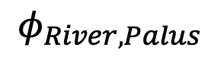
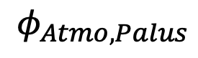










This brainstorm involves carbonate and water species… too complicated for in-class model exercise
Box Model… Open, Steady-State System
Inputs
Main Reservoir
Outputs
$$φ_{Precip, Palus}$$
$$φ_{palus, evap}$$
Palustrine Basin
$$δ^{18}O_{H2O,precip}$$
$$δ^{18}O_{evap}$$
$$δ^{18}O_{H2O,palus}$$
$$φ_{River, Palus}$$
$$φ_{palus,carb}$$
$$δ^{18}O_{H2O,river}$$
$$δ^{18}O_{carb}$$
$$δ^{18}O_{CO2,atmo}$$
$$φ_{Atmo, Palus}$$
$$δ^{18}O_{CO2,atmo}=δ^{18}O_{H2CO3}$$

Slide 43

System Schematic… Palustrine ecosystem, i.e. shallow wetland environments: δ18Ow to δ18Omin
Precipitation
Evaporation
River In-Flow
Calcite
Crystallization

